Slide 1


Final Project Computer Software Technology for a Student Portal
By Yulia Ferguson
Notes:
Hello, everyone! My name is Yulia Ferguson. I am going to walk you through this project, which is a student portal that allows user to register, log in, enroll in courses, unenroll in courses, view their information, and log out. There are many aspects of this project. First, there is a Software Requirements Specifications document that spells out the important details of the project. UML design models have also been developed for this project to illustrate the functionality and important features. The website itself is created with PHP code. XAMPP is used to create a local server that hosts the website. The website also connects to a MySQL database which is managed in PHPMyAdmin. This database includes several tables that save user, course, and registration information. Let’s dig into the specifics of this project.

Slide 2

Software Requirements Specification Document
The SRS document describes the project’s purpose, functionality, and features (Chikh & Alajmi, 2014).
Features:
New User Registration
User Login
Course Management
Notes:
The Software Requirements Specifications document is an important starting point for the project, as it describes the project’s purpose, functionality, and features. The document also describes the type of users that will use the webpage. In this case, the project is a Student Portal that will allow users manage their profiles and enroll and unenroll in courses.
The Software Requirements Specifications document for this webpage describes these features that the system must have: New User Registration – the system must provide a user registration process that includes both account and profile creation. User Login – Registered users will have the ability to log in using a unique ID and password created during registration. Course Management – The system will manage online courses that are available for students to enroll in.

Slide 3
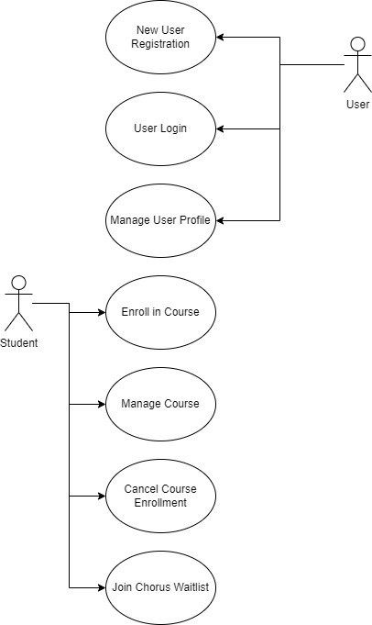
UML Design Diagrams
Use Case Diagram (Tsui, & Bernal, 2018)
Notes:
Now, let’s look at another important piece of the project – UML design models.
These diagrams portray the ways the system may be used. The Use Case diagram demonstrates the ways in which users can interact with the system. Generic users, like staff, can create an account, log in, and manage their profile. However, users that are students have additional capabilities. They can enroll in courses, manage their courses in their profile, cancel enrollment in a course, and even join a course waitlist.

Slide 4
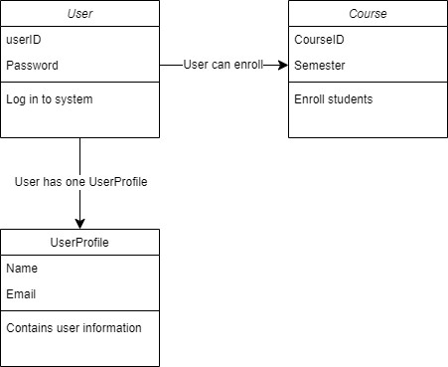
UML Design Diagrams
Class Diagram
Notes:
The Class diagram displays the relationship between various classes in the portal. The diagram shows the relationships between the User and Course classes, as well as the User and UserProfile classes.

Slide 5
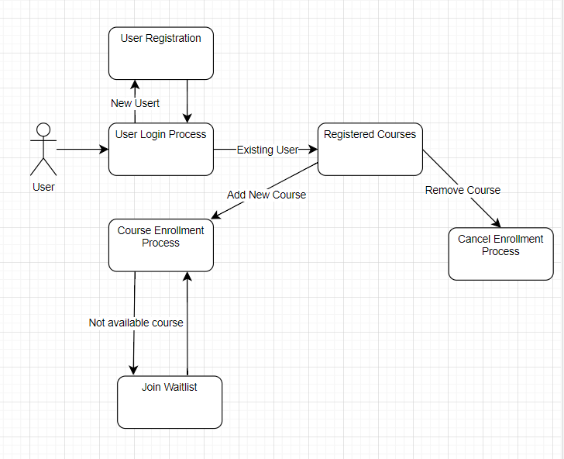
UML Design Diagrams
Sequence Diagram
Notes:
The Sequence Diagram displays the sequence of events that occurs as a user interacts with the system.

Slide 6
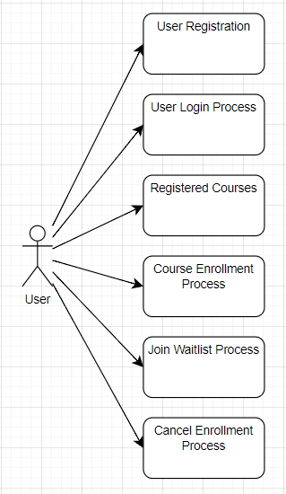
UML Design Diagrams
Activity Diagram
Notes:
The Activity diagram shows the various actions a user can take in the webpage.

Slide 7
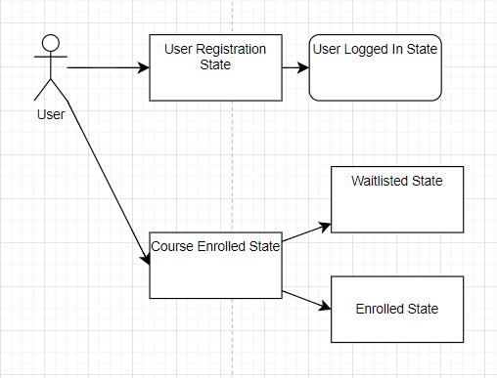
UML Design Diagrams
State Diagram
Notes:
Finally, the state diagram shows the various states the system goes through as the user interacts with the system.

Slide 8
Landing, Login, and Registration
Landing Page – the main page of the portal.
Login Page – allows a user to enter credentials to log in.
Registration Page – Allows a new user to create an account.
Notes:
Next, let’s dive into actual code used to create the webpage. The landing, login, and enrollment pages are written with PHP code.
The landing page is the main page of the student portal. This page actually checks to see if a user is currently logged in to determine what links to display. If a user’s ID is stored in the current session, the system knows a user is logged in. It will then display options to view their profile, logout, or enroll in courses. If no user is logged in, the page displays options to register a new account, or for an existing user to log in. The login page allows a user to enter their credentials to log in. These credentials are then checked against the records stored in the MySQL database. If the credentials match, the user is logged in. If the credentials do not match, the user is informed that there has been an error. The registration page allows a user to create a new account by entering in their information. When they click register, the user will be informed if the account creation is successful or not. If the creation is successful, the user’s information will be saved in the MySQL database, and they will be assigned a unique UserID.

Slide 9

MySQL Database
MySQL Database – Saves information in three tables (Connolly & Hoar, 2018):
tblUser – contains user information
tblCourses – contains course information
tblRegistrations – contains records of course enrollments
Notes:
Let’s talk now about the MySQL database, which is managed in PHPMyAdmin. This database is a critical component of the system, as it maintains the info the system needs to function. This information is saved in three tables: tblUser contains all of a user’s information that they entered during registration.
tblCourses contains the information of the current courses that are offered.
tblRegistrations saves records of which courses each student is enrolled in.
All of these databases are important for the Course Enrollment page to function properly. When a user logs in, their unique ID is saved into the current session. The user can then navigate to the Course Enrollment page where they can choose to enroll in any available course. When they click enroll, a new record is created in tblRegistrations to save the enrollment.

Slide 10

Two Important Scripts
Logout.php – logs the user out by destroying the session that stores their ID.
Connect.php – contains the information needed to connect to the MySQL database.
Notes:
There’s two more important scripts of the PHP code for this system. First, is the logout function. When a logged-in user clicks logout, the webpage runs a php script called logout.php. This script deletes the users ID from the session, effectively logging them out.
Second, is a very important script called connect.php. This script contains all the information the system needs to connect to the MySQL database. This script is invoked anytime the system needs to read or write information to the database.

Slide 11
Conclusion
References
Chikh, A., & Alajmi, H. (2014, January 17–19). Towards a dynamic software requirements specificationLinks to an external site. [Paper presentation]. 2014 World Congress on Computer Applications and Information Systems (WCCAIS), Hammamet, Tunisia. https://doi.org/10.1109/WCCAIS.2014.6916656
Connolly, R., & Hoar, R. (2018). Fundamentals of web development (2nd ed.). Pearson.
Tsui, F., Karam, O., & Bernal, B. (2018). Essentials of software engineering (4th ed.). Jones & Bartlett Learning.
Notes:
That concludes this overview of this Student Portal project. This project demonstrates the creation of a usable student portal, beginning with the planning stage, and ending with a usable student portal. Thank you for listening and have a great day!

